Slide 1
Pizza Restaurant Analysis in US
Group Members:
Chau Ka Yan (1155158643)
Chen Lu (1155157122)
Fan Jingyi (1155157249)
LI SHENGWEI (1155143605)
LUI CHAK SUM (1155158054)
Wong Tuen Hung (1155158385)
Notes:
(p1) Good afternoon Mr. Liu. Thank you for choosing Group 1 company to do the data analysis of pizza restaurants in the United States. Our team is in charge of your request and our members are Connie, Helen, Chloe, George, Ivy and Me, Sam.

Slide 2
Background Information
This year is 2016.
From the data set we collected, there are at least 1,749 pizza restaurants operating in the US.
You are interested in entering the competitive pizza restaurant market.
You hired us to provide professional analysis and give some advices on setting up the restaurant.
Notes:
(p2) According to your request, you want to operate a pizza restaurant, so we have collected some data and found out that there are over 1,700 pizza restaurants operating this year.

Slide 3
Problem Statement
What decisions should you make regarding important factors such as pizza pricing, menu options, restaurant location, branding, and other strategies to set your pizza restaurant up for success?
Notes:
(p3) So the problem is, what decisions should you make regarding the business factors to stand out from the competition?

Slide 4
TABLE OF CONTENTS
01
02
03
04
Data Preparation
Data Visualization
Regression
Confidence Interval & Prediction Interval
05
Decision Tree
06
Conclusion
Notes:
(p4) To solve your problem, we did diversified analysis, as shown in this table of content. Now, George will explain how we prepare for the data first.

Slide 5
01
Data Preparation
Analysis start with high quality data

Slide 6
Data Checking
20 Variables in the data set (address, city , latitude, longitude etc.)
There are N/A or zero data in the numeric variables which are maximum price and the minimum price of pizzas.
N/A and zero data can cause the calculation mistakes when the formula is applied in the R or Python
Data Cleaning
Data Imputation

Slide 7
Data Cleaning(1)
If data cleaning is applied, 563 data will be dropped out based on N/A and zero data in the maximum price variable.
However, those data still contain much valuable information such as "pizza name" and "address".

Slide 8
Data Imputation
Keeping data is preferred instead of deleting data.
Use sample mean to replace the N/A data and zero data by python sklearn.impute simpleImputer function.
Finally, N/A and zero values of Maximum and Minimum data are replaced by mean(12.48) and mean(11.43) respectively.

Slide 9
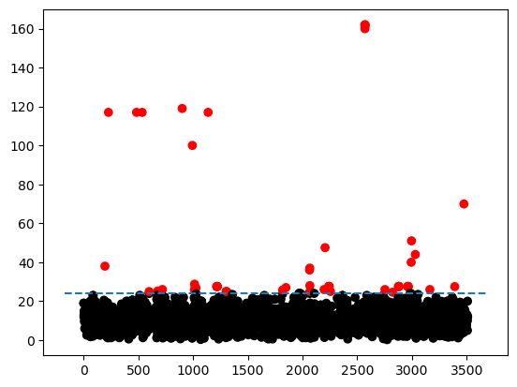
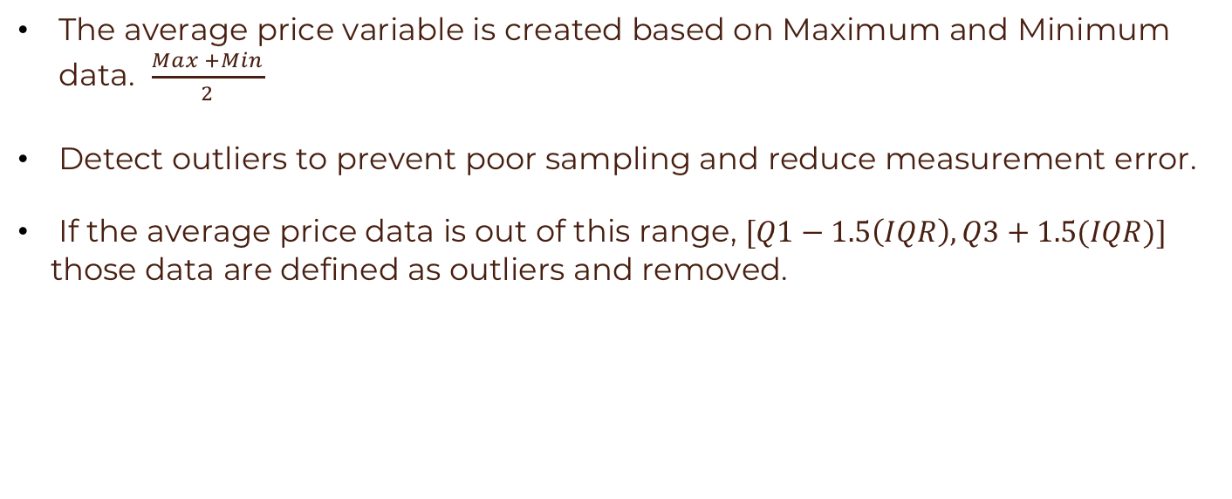
Data Cleaning(2)
The average price variable is created based on Maximum and Minimum data. $\frac{Max +Min}{2}$
Detect outliers to prevent poor sampling and reduce measurement error.
If the average price data is out of this range, $[Q1−1.5\left(IQR\right),Q3+1.5(IQR)]$
those data are defined as outliers and removed.
59 outliers are detected and deleted in our data set

Slide 10
02
Data Visualization
Enable understanding of complex data analytics
Notes:
(P10) Thank you, George, for explaining how we prepare for the data. In the following, we will show data visualization to understand complex data analytics.

Slide 11
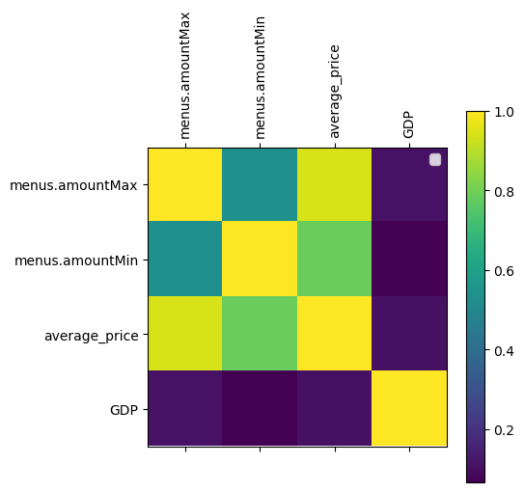
Correlation between Variables
Maximum price has the highest positive correlation with average price within other two variables.
Minimum price has the second highest positive correlation with average price
GDP is lower correlated with other three variables.
Notes:
(P11) First, let’s see the correlation between prices and GDP. As you can see, the maximum price positively correlates with the average price within the other two variables. At the same time, the minimum price has the second-highest positive correlation with the average price. However, GDP has the lowest correlation with the other three variables.

Slide 12

Data Visualization
1.Restaurant Brand
2.Pizza type
$
3.Average price
4.State and location
Notes:
(P12) Then, our data visualization is divided into four parts: we want to know the most popular restaurant brand, pizza type, the most prevalent average price for pizza, and the state and location of the pizza restaurants.

Slide 13
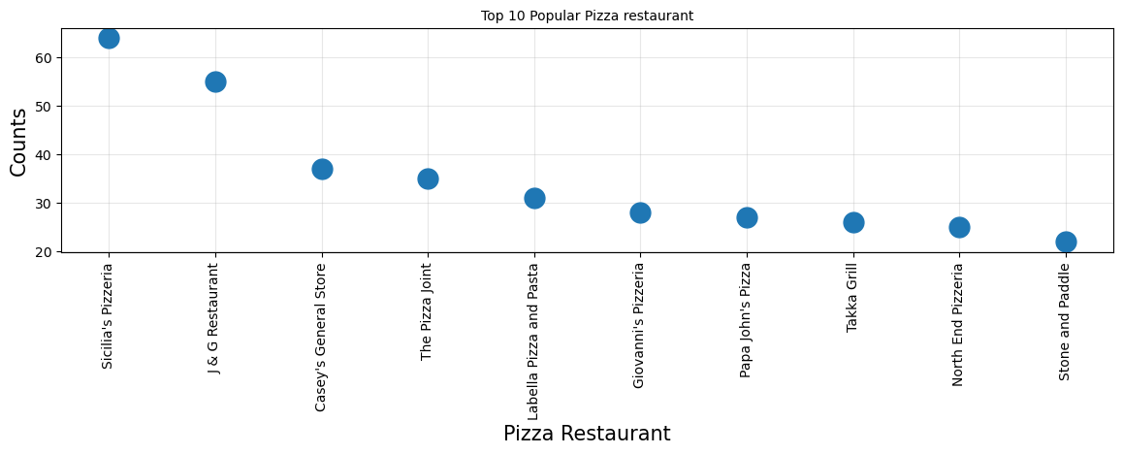
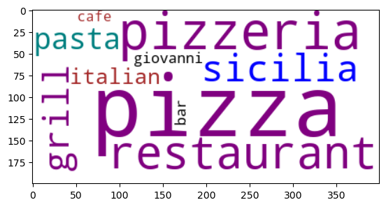
The Top 10 Pizza Restaurant brands in the US
Rank​ | Pizza Restaurant Name | Frequency​
1​ | Sicilia's Pizzeria | 64
2​ | J & G Restaurant | 55
3​ | Casey's General Store | 37
4​ | The Pizza Joint | 35
5​ | Labella Pizza and Pasta | 31
6​ | Giovanni's Pizzeria | 28
7​ | Papa John's Pizza | 27
8​ | Takka Grill | 26
9​ | North End Pizzeria | 25
10​ | Stone and paddle | 26
Notes:
(P13) First, let's see the top 10 pizza restaurant brands in the US. From the table and the word cloud, we can see that the most popular pizza restaurant brand is (animation) Sicilia's Pizzeria, which has a total of 64 restaurants. So, if we are planning to join a chain, this pizza restaurant is a good choice.
After showing the pizza restaurant brand, then we want to know which is the most popular pizza that those restaurants are selling.

Slide 14
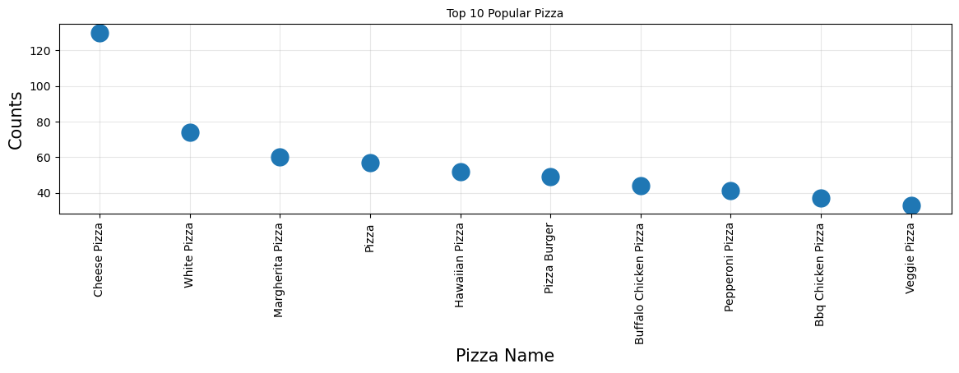
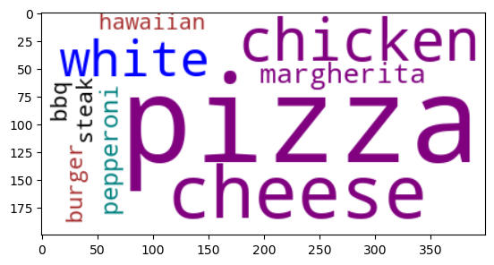
The Top 10 Popular Pizza in menus
Rank | Pizza Name | Frequency
1 | Cheese Pizza | 130
2 | White Pizza | 74
3 | Margherita Pizza | 60
4 | Pizza | 57
5 | Hawaiian Pizza | 52
6 | Pizza Burger | 49
7 | Buffalo Chicken Pizza | 44
8 | Pepperoni Pizza | 41
9 | BBQ Chicken Pizza | 37
10 | Veggie Pizza | 33
Notes:
(P14) This table and the word-cloud show that the most popular pizza type is (animation) cheese pizza, which has 130 counts, then (animation) white pizza and (animation) Margherita pizza. Hence, we can consider these pizza types in our menus for our setup.

Slide 15
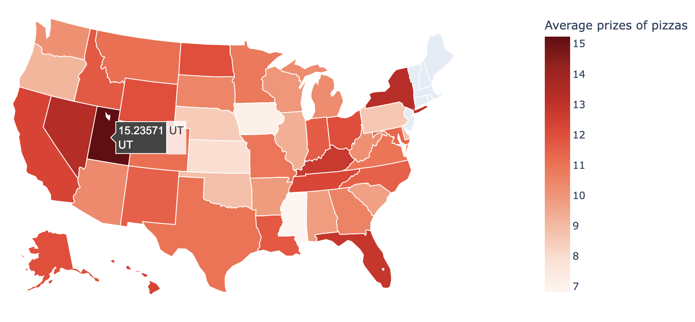
Average Prizes of Pizzas in the states
Rank​ | States | Prices
1​ | UT(Utah) | 15.24
2​ | NV(Nevada) | 13.35
3​ | NY(New York) | 13.28
4​ | FL​(Florida) | 12.83
5​ | KY(Kentucky) | 12.73
Notes:
(P15) Then, we would like to know about the average prices of pizzas. From the map and the table, we can find that the highest average price of pizza is 15.24 US dollars, which is from Utah, followed by Nevada and New York, which are about 13 US dollars. Also, by our glance at the map on the right-hand side, we can find that most average prices of pizzas are laid between 10 to 13.
Last, after we have brief ideas about the pizza brands, menu and the prices of pizza, then we may want to know where our pizza restaurant should be set up.

Slide 16
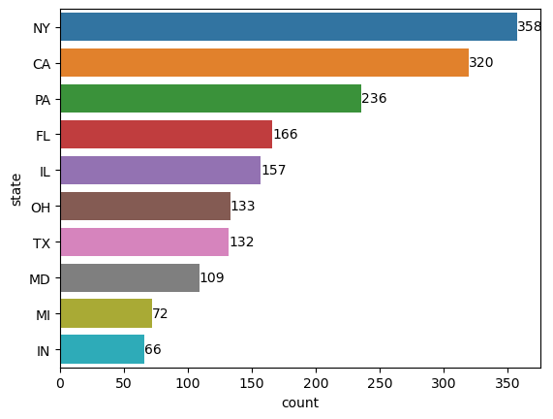
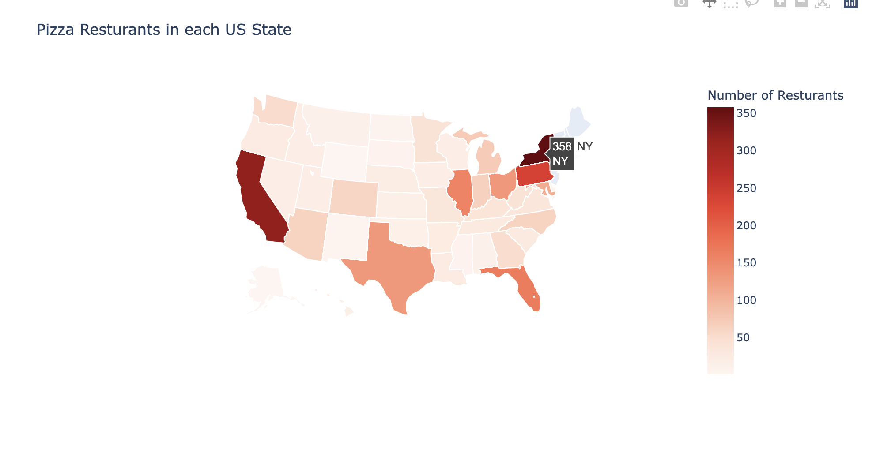

The Top 10 States in Amount of Pizza Restaurants in the US
320
CA
The top three states in amount of pizza:
NY: New York
CA: California
PA: Pennsylvania
Notes:
(P16) From the US map on the right hand side, we can see that (animation) New York and (animation) California have the highest number of pizza restaurants. Then, from the graph shown on the left, we can see the top three states in amount of pizza restaurants are (animation) New York , which has a total of 358 pizza restaurants, which is a huge number compared with most of the other states, then followed by California and Pennsylvania.
And this is the end of the data visualization. However, these results are just a rough idea for our set up. For more detailed analysis, let our other teammate explain to you. So now, I will pass to Chloe for the regression analysis.

Slide 17
03
Linear Regression Model
What factors are affecting the profit?
Notes:
(P17) Thanks Ivy. So, as investors, we are very interested in determining what factors affect the profit. In other words, our ultimate target is indeed, to figure out how to make more money. So, in this part, we build a linear regression model to analyze our data.

Slide 18
Linear Regression Model
Definition: Linear regression attempts to model the relationship between two variables by fitting a linear equation to observed data.
Utilize: In our analysis, we built linear regression models to find out which factors can bring more profits for investors.
Notes:
(P18) Firstly, let me give you a brief introduction to this model. (animation) Linear regression is the most common regression model, which attempts to model the relationship between two variables by fitting a linear equation to observed data.
(animation) In our analysis, we built linear regression models aiming to find out which factors can bring more profits for investors.

Slide 19
Profit VS. GDP
There is a much tighter correlation between corporate profits and economic growth.
Approximate
Profit
GDP
Resource:
2016 US Real GDP by state: Accommodation and food services
Notes:
(P19) According to Steve Hansen, there is a very tight correlation between corporate profits and economic growth. So in our analysis, we utilize the 2016 US Real GDP by the state (animation) to approximate (animation) the profit (animation) made by pizza res.

Slide 20
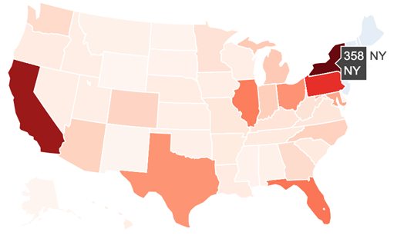
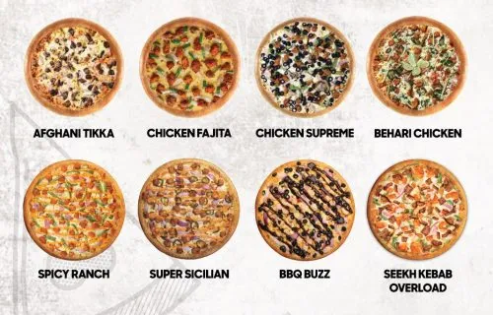


Variables Choosing
The popularity of res. location
The variety of pizza flavor
The price of pizza
The popularity of certain pizza flavors
Notes:
(P20) Based on the data we collected, our analysis chose four factors (animation), which are.(animation) The popularity of res. Location, (animation)the price of the pizza, (animation)the variety of pizza flavors, and (animation) the popularity of a certain flavor.

Slide 21
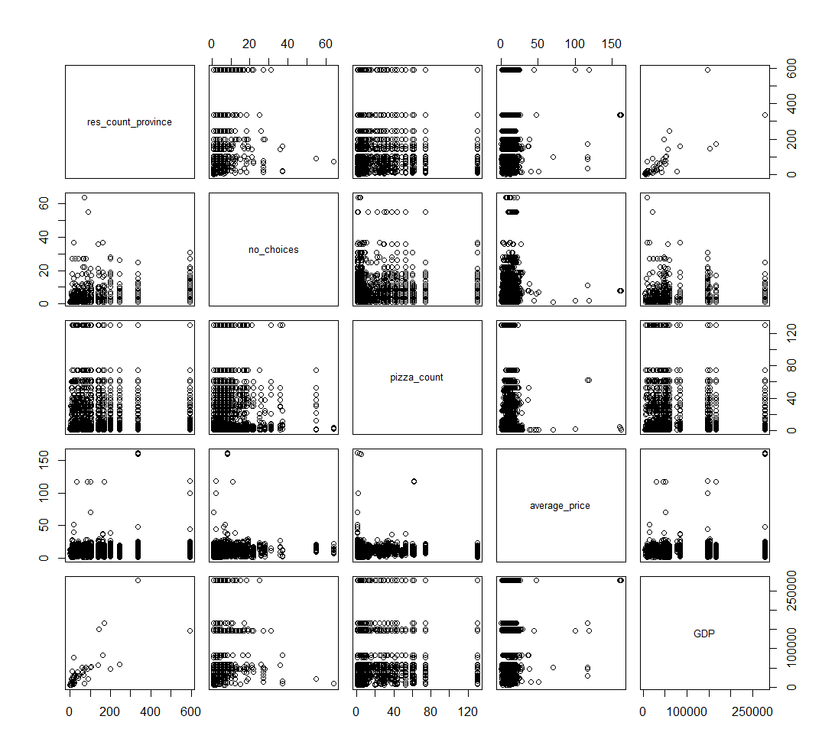
Virtualize relationships
A linear relationship can be observed between GDP and the popularity of res. location
Scatter plot
Notes:
(P21) In the beginning, we used R programming to virtualize the relationships between these four factors and GDP. As we can see from the scatter plots (animation), there is a positive linear relationship (animation) between GDP and the popularity of res. Location.

Slide 22
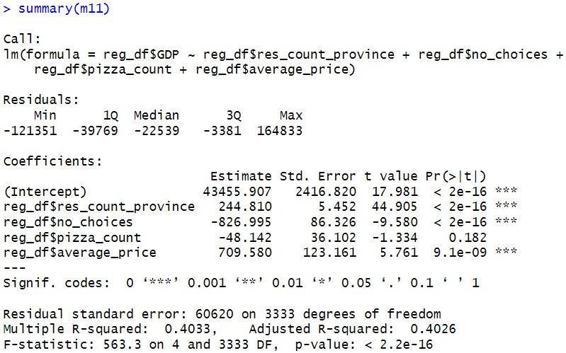
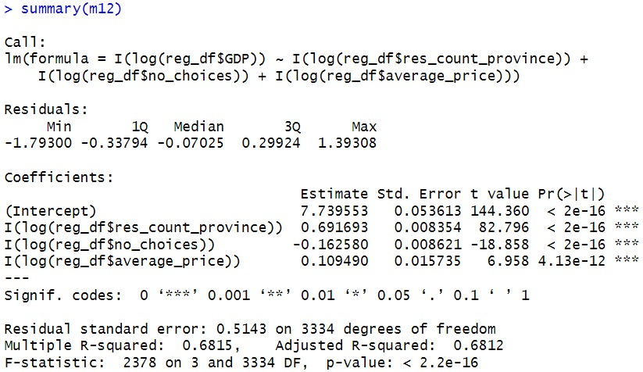
Fit Data into the Model
Apply log transformation and drop the popularity of a certain pizza flavors
Better Model!
Notes:
(P22) Digging into more details, we first fit data into model 1 (animation). The summary result shows that there is a relatively larger p-value of pizza count, which represents that there is a less obvious linear relationship between the popularity of a certain flavor and GDP.
So we make some adjustments to the model: we take (animation) log transformation on the data and drop the pizza count variable. (animation) We can see that the R-squared value (animation) is larger than the previous one, which means it is a better-fitting (animation) model!

Slide 23
Variables Choosing Modified
The popularity of res. location
The variety of pizza flavor
The popularity of certain pizza flavors
The price of pizza
Notes:
Let's (animation) drop this variable. And Move to the model examination part.

Slide 24
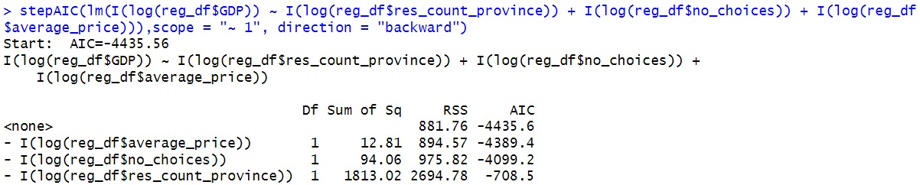
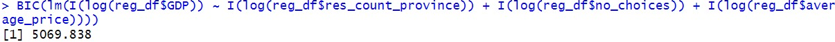
Examine the Model
The Akaike information criterion (AIC) and the Bayesian information criterion (BIC) provide measures of model performance that account for model complexity.
They combine a term reflecting how well the model fits the data with a term that penalizes the model in proportion to its number of parameters.
32,7%
10,9%
Notes:
(p24) As explained by Chloe, we dropped the variable pizza count as it has a large p-value. Due to the programming design of R, that p-value is actually testing whether we should include the factor when other factors are included. So, we also need to examine our model by AIC and BIC to check the significance of remaining factors. The criteria of AIC and BIC is to choose the model with the smallest (animation) AIC and BIC.

Slide 25
Examine the Model
By comparing to other models, our choices of predictors are significant, which has the smallest AIC and BIC.
The model is finalized!
32,7%
10,9%
Notes:
(p25) by comparing to other possible models with different combinations of factors, as you can see from the picture, our model has the smallest AIC and BIC value, which means our model is already the best. Great!

Slide 26
Conclusion
Investors could consider the following to make more profits:
Operating res. In the provinces with enormous popularity
Limiting the provided flavor of pizza
Increases the pizza price
Notes:
(p26) So in conclusion, by interpretation of the coefficient of predictors, we suggest you to (animation) operate your restaurant in the province with enormous popularity, which Ivy presented, is New York. Also, you may (animation) limit the provided flavor of pizza and (animation) increase the pizza price. But, you may wonder what should be the interval for the price increase. Now, Connie will answer this question by introducing the next topic.

Slide 27
04
Confidence Interval & Prediction Interval
What range of the price we should set to maximize our profit?
Where should we operate the pizza restaurant?
Notes:
(p27) Thank you, Sam. And now, since we are interested in how to maximize the profit, therefore in this part we calculate the confidence interval of the average price of pizza, then we can know the range of the pizza price we can set. Also, we calculate the prediction interval of GDP, then we can know where we should operate the pizza restaurant.

Slide 28
Confidence Interval (CI)
Definition: The confidence interval (CI) is the range of values that you expect your estimate to fall between a certain percentage of the time if you run your experiment again or re-sample the population in the same way.
Utilize: In our analysis, we calculate the CI of the average price of pizza and the CI of the average price of the 5 most common pizzas, respectively.
Notes:
(p28)First of all, let me briefly introduce the CI to you. (animation)The CI is a range of values that if we re-sample the population or redo the experiment in the same way, we expect our estimate will fall between a certain percentage of the time. (animation) In our analysis, we calculate the CI of the average price of pizza and the CI of the average price of the 5 most common pizzas, respectively.

Slide 29
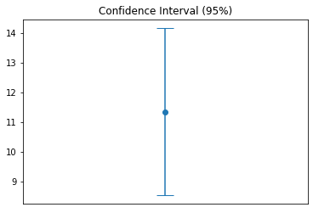
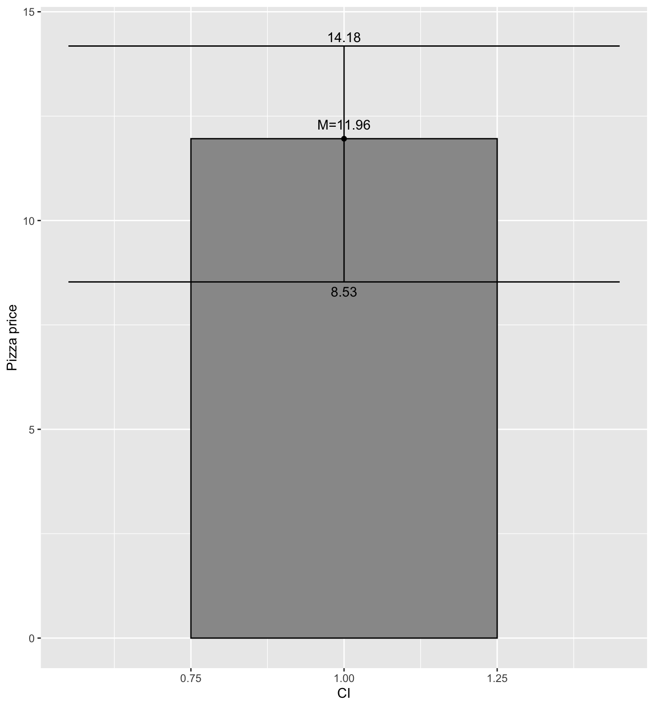

Visualize the confidence interval
For all pizzas, the CI of the average price is (8.53, 14.18).
Notes:
(p29)Let's see the result of the CI of the average price of all pizzas (animation). From the graph, we can see the CI is from 8 . 5 3 to 14 . 1 8 dollars. Therefore, we can set or increase the pizza price according to this interval.

Slide 30
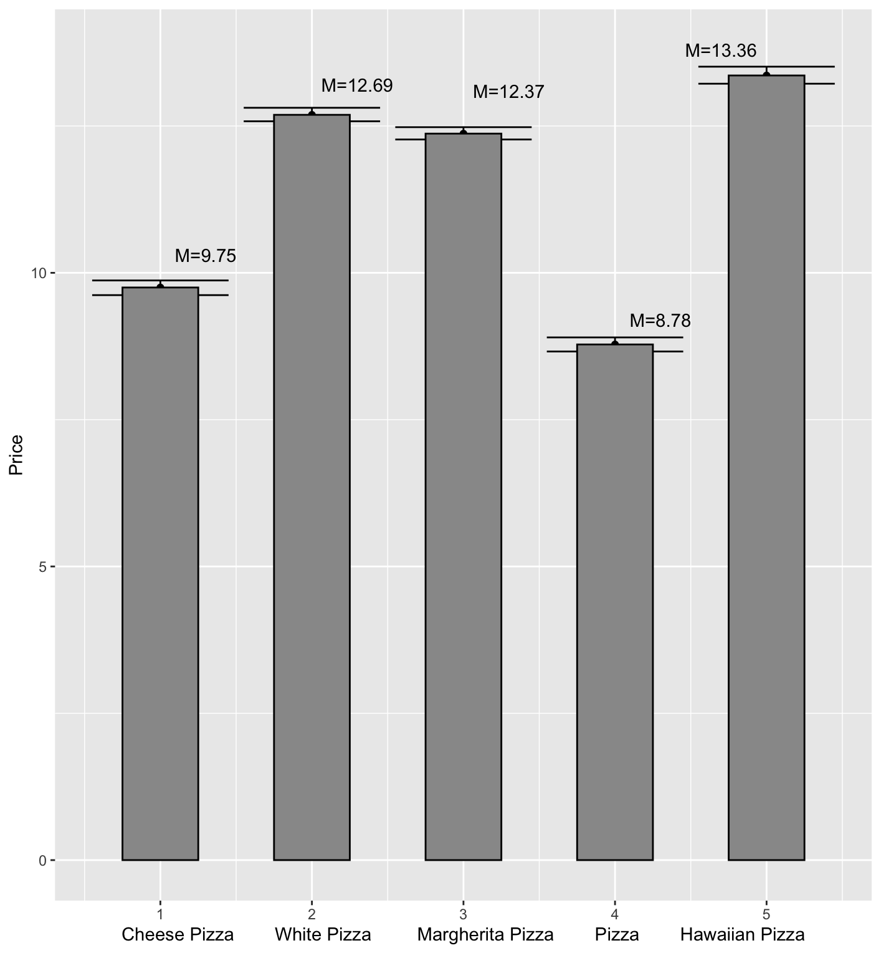
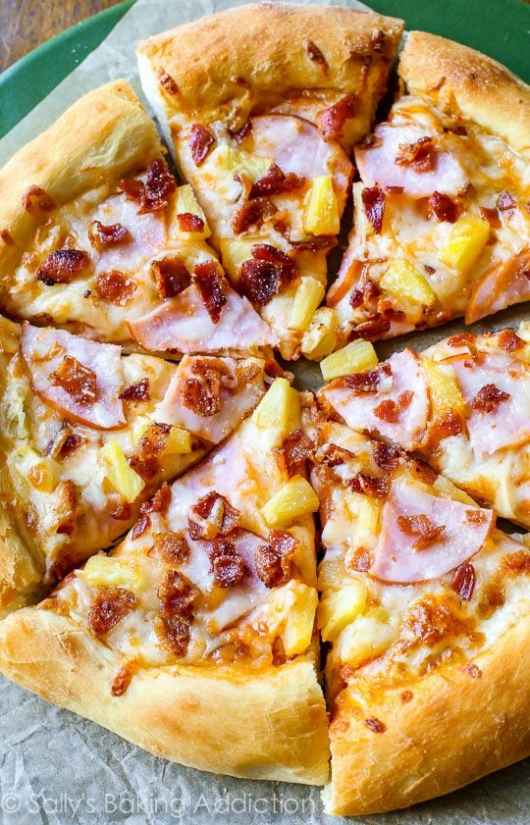
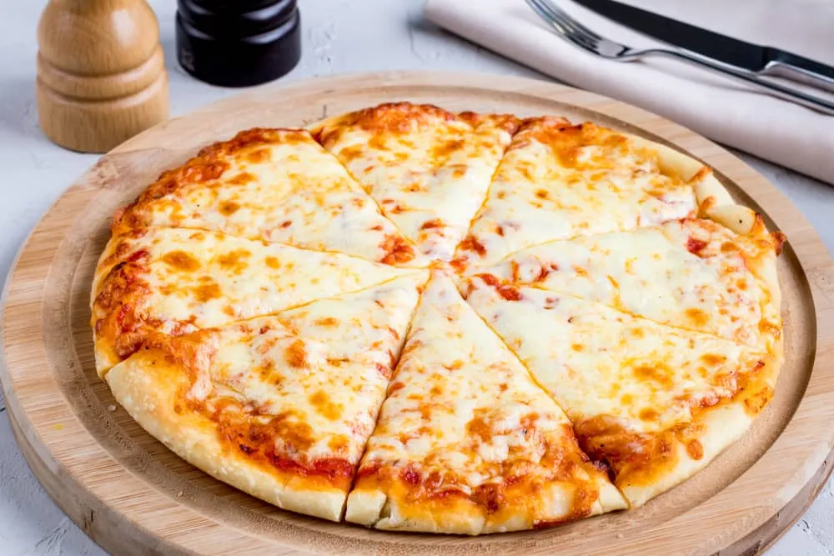
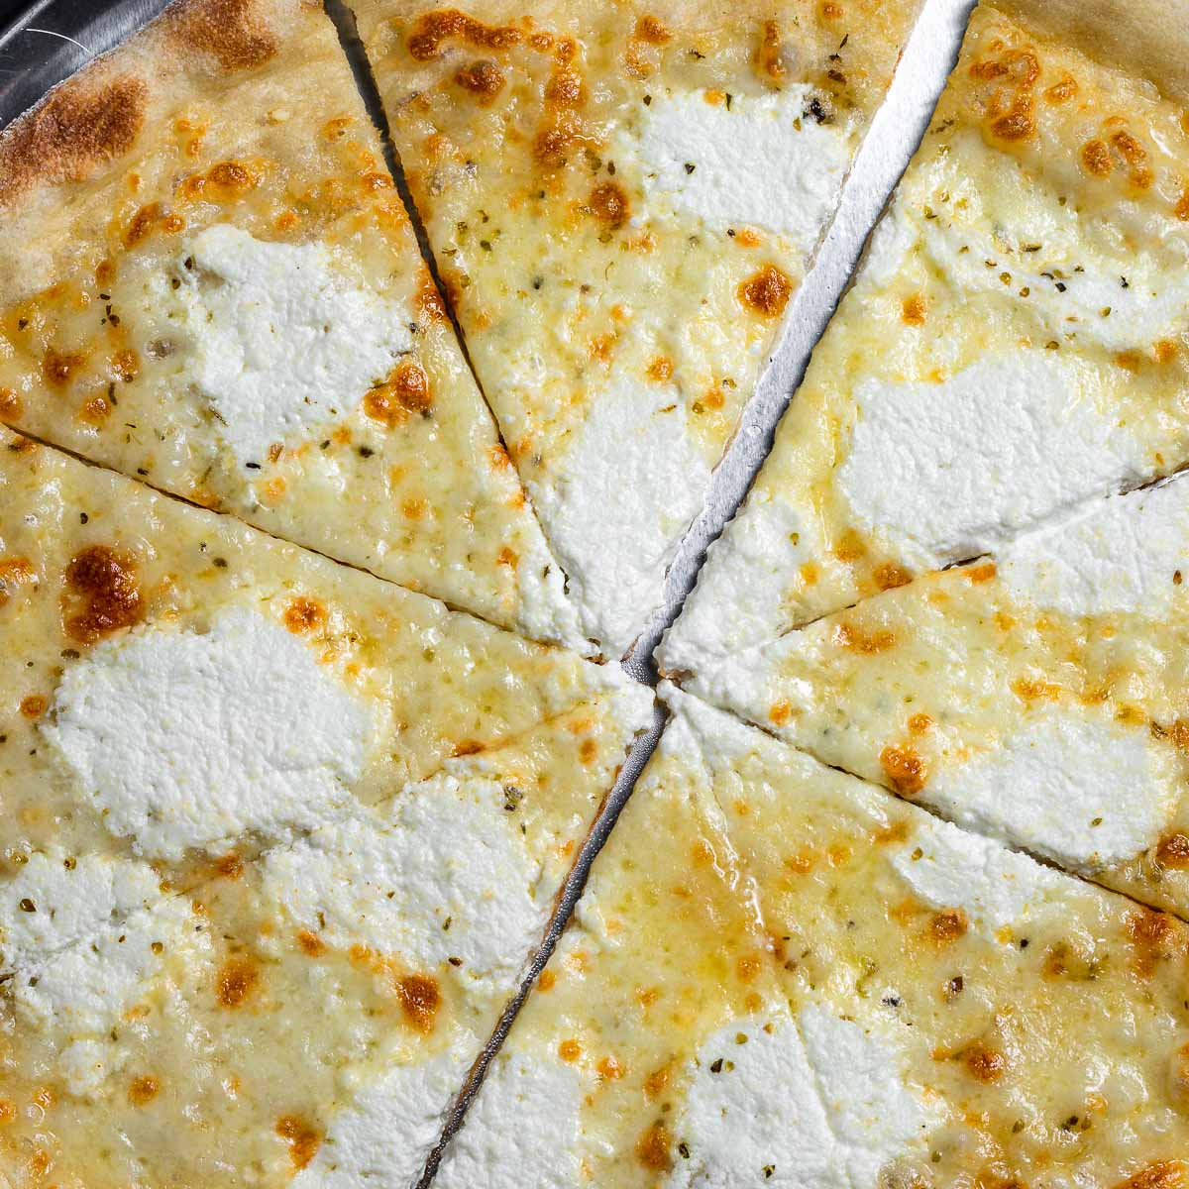
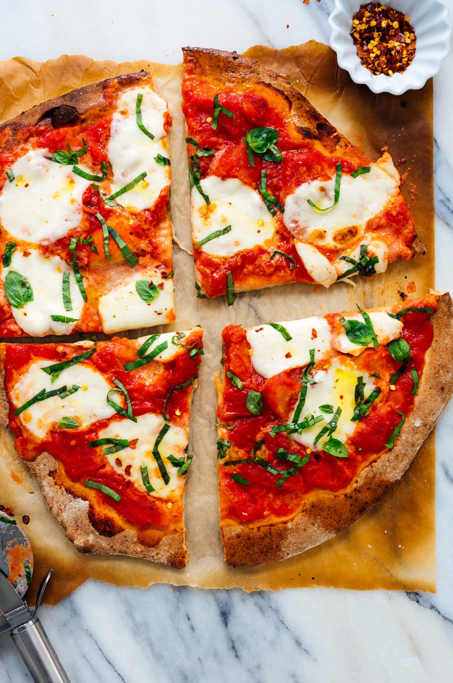
Visualize the confidence interval
Pizza Name | Price Range
Cheese Pizza | (9.62, 9.87)
White Pizza | (12.58, 12.81)
Margherita Pizza | (12.27, 12.48)
Pizza (Specific name not provided) | (8.66, 8.90)
Hawaiian Pizza | (13.22, 13.51)
Notes:
(p30) Next, let's see the result of the CI of the average price of the 5 most common pizzas. (animation). The CI for Cheese pizza ,White Pizza,Margherita Pizza, Hawaiian Pizza and for those pizza which do not have specific names are shown on this table and we can set the price of these type of pizza according to the interval.

Slide 31
Prediction Interval (PI)
Definition: A prediction interval (PI) is an estimate of an interval in which a future observation will fall, with a certain probability, given what have already been observed.
Utilize: In our analysis, we predict the prediction interval for GDP in a profit maximize situation.
Notes:
(p31) After that, let me briefly introduce the PI to you. (animation) Prediction interval is an estimate of an interval that a future observation will fall, with a certain probability, based on what have already been observed. (animation) In our analysis, we predict the PI of the GDP in a profit maximize situation.

Slide 32



Profit maximize situation
Increases the pizza price
CI upper limit for average price
Limiting the provided flavor of pizza
CI lower limit for the number of flavors choices
Operating res. In the provinces with enormous popularity
CI upper limit for the number of restaurants in provinces
Notes:
(p32) The profit maximize situation is obtained in the regression result before. (animation) From the result, We should operat res. In the provinces with enormous popularity, therefore (animation) we use the CI upper limit for the number of restaurants in PI calculation. (animation) Also, we should Limit the flavor of pizza we provided, thus (animation) the CI lower limit for the number of flavors choices is used. (animation) And we should Increases the pizza price to maximize the profit, (animation) thus the CI upper limit for average price of pizzas is used.

Slide 33
Prediction Interval
Result:
The required 95% PI for GDP is
(33002.09, 248066.12)
Notes:
(p33) After applying this profit maximize situation, (animation) we obtained the PI of the GDP which is from around 33 thousand millions to 248 thousand million. Therefore, we should operate the pizza res. in the province with GDP within this PI. Then, George will introduce the decision tree to you.

Slide 34
05
Decision Tree
Predict the pizza price range by training model

Slide 35
Decision Tree Steps
Based on the mean of average price of pizza($11.96), create a new variable price.status.
If the average price of a pizza is higher than the mean, it is defined as Expensive, otherwise Normal.
39.7% pizza prices are expensive and 60.3% pizza prices are Normal.
According to the price.status variable, decision tree is applied to find out decision rule from other numeric variables exclude average price.

Slide 36




Decision Tree Steps
Training data | Test data
3000(85.47%) | 510(14.53%)
5. Random select 3000 samples from
the data set to train our decision tree
model.
6. Based on this training data, a decision tree
model is generated in R.
Data set
Training data
.
.
.
Random select

Slide 37
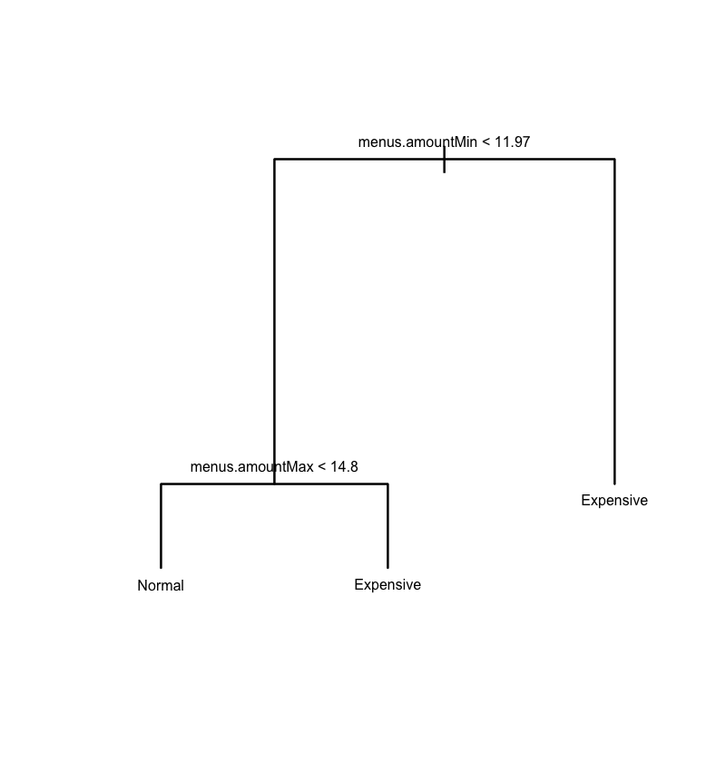
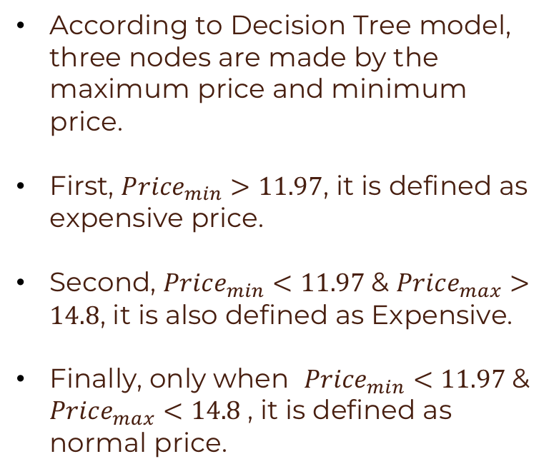
Decision Tree Result
According to Decision Tree model, three nodes are made by the maximum price and minimum price.
First, ${Price}_{min}>11.97$, it is defined as expensive price.
Second, ${Price}_{min}<11.97$& ${Price}_{max}>14.8$, it is also defined as Expensive.
Finally, only when ${Price}_{min}<11.97$& ${Price}_{max}<14.8$, it is defined as normal price.

Slide 38
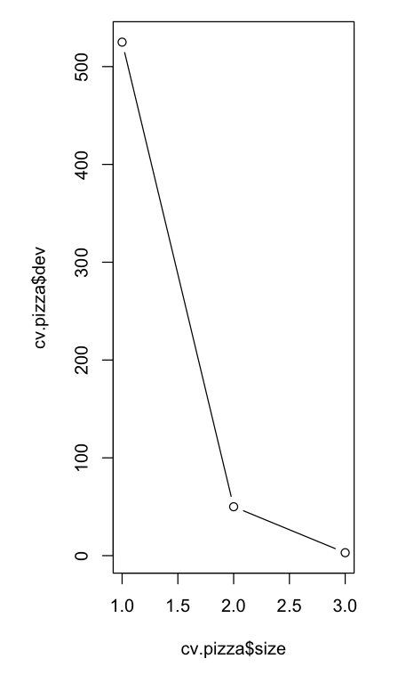
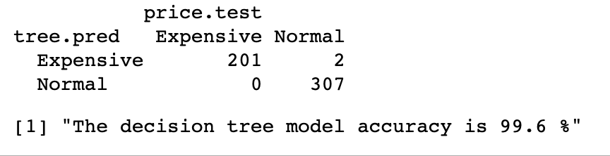
Decision Tree Test
Next, use this model to predict the price.status of the test data.
Then, Check the accurate rate between the prediction and real result.
Cross validation

Slide 39
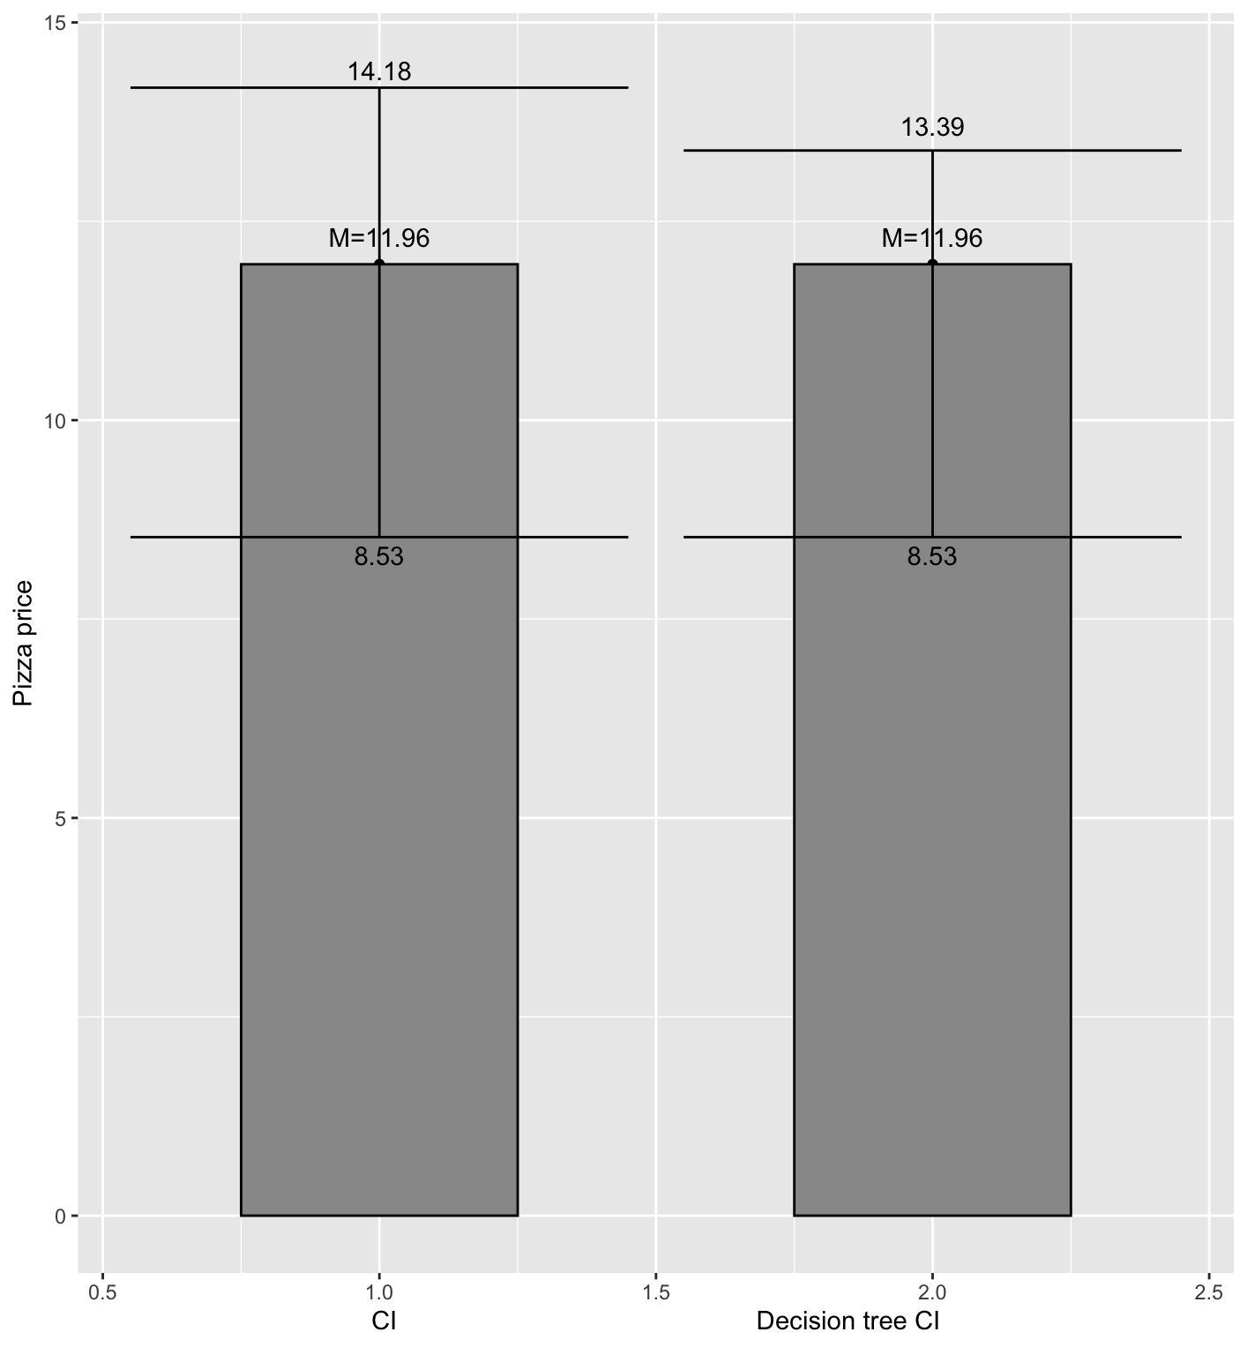
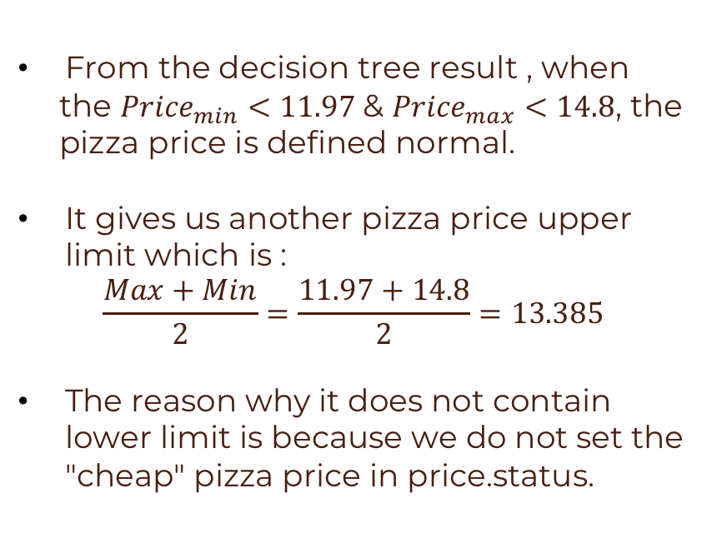
Decision Tree Application
From the decision tree result , when
the ${Price}_{min}<11.97$& ${Price}_{max}<14.8$, the
pizza price is defined normal.
It gives us another pizza price upper limit which is :
$$\frac{Max+Min}{2}=\frac{11.97+14.8}{2}=13.385$$
The reason why it does not contain lower limit is because we do not set the "cheap" pizza price in price.status.

Slide 40
06
Conclusion
Notes:
(P40): Thank you, George, for introducing the decision tree to us. Now, let me give you some recommendations for operating a pizza restaurant and I will evaluate the model we used.

Slide 41
Recommendations
 | Plan | Remarks
Pizza Brand | Do not join any chain restaurant, set up our own restaurant | Save money from the franchise fee
Pizza Type | The flavors of pizza should be limited | Cheese, White, Margherita, pizza and Hawaiian
Pizza Price | Use the decision tree | (8.53, 13.39)
Res. Location | Set it in the provinces with enormous popularity | New York, California, Pennsylvania
Notes:
(P41): First of all, you could choose not to join any chain restaurant, so you can save money from franchise fees. For the flavors of pizza, it should be limited, we can choose Cheese, White, Margherita, pizza and Hawaiian. The next point is about the price. From our analysis, we can use the decision tree to keep the price at a normal interval, so the price should be kept in the interval of (8.53,13.39).

Slide 42
Pizza Restaurants Locations in the US
NY: New York
CA: California
PA: Pennsylvania
Notes:
(P42): For the location of the pizza restaurant, we suggest you set it in the provinces with enormous popularity, such as New York, California, Pennsylvania. The last point is that when the GDP is in the interval as Connie introduced, we can maximize the profit.

Slide 43
Model Evaluation
Linear Regression
Strength:
The regression analysis is straightforward and easy for us to see whether business factors we used are related to the GDP.
Weakness:
We applied log transformation, which could make the interpretation of coefficient become more complicated.
Data visualization
Strength:
We can see the result directly from the image and get a rough result immediately.
Weakness:
Lack of the key information such as pizza sales and pizza profit in the data set
Notes:
(P43): Then, I will evaluate the model we have used. For the data visualization, we can see the result directly through the image and get a rough result immediately, but it lacks the key information such as pizza sales and profit in the data set. For linear regression, it’s straightforward and easy to see the relationships between variables, but we applied log transformation, it could make the interpretation of coefficients become more complicated.

Slide 44
Model Evaluation
CI and PI:
Strength:
A specific range can be obtained.
Weakness:
For prediction interval, the range is too large, so the reference value is not high.
Decision Tree
Strength:
Successfully find out the result of the decision rule
the accurate rate is 99.6%
Weakness:
The definition of Normal and expensive price is based on the average price, it could not reflect the actual expensive price definition of US citizens.
The data sets only included limited numeric variables, so the decision tree only took two variables (max and min) to decide it.
Notes:
(P44): Now, let’s see the confidence interval and prediction interval. Both of them can give us a specific range of the variable, but the range of the prediction interval is too large, so the reference value of it is not high. Finally, for the decision tree, we can successfully find out the result of the decision rule and the accuracy is high. However, the definition of normal and expensive price is based on the average price, it could not reflect the actual expensive price of American citizens. What’s more, the data set only included limited numeric variables, so, the decision tree only took two variables to decide it.

Slide 45
REFERENCE
DATA
https://raw.githubusercontent.com/rajeevratan84/data-analyst-bootcamp/master/8358_1.csv
2016 US Real GDP by state: Accommodation and food services
https://www.zipcode.com.ng/2022/06/list-of-5-digit-zip-codes-united-states.html
CODING
Data-Science-Analytics-AI-for-Business-the-Real-World-/Pizza Resturants Analysis.ipynb at main · PacktPublishing/Data-Science-Analytics-AI-for-Business-the-Real-World- (github.com)
POWERPOINT
Learning Fractions Google Slides theme and PowerPoint template (slidesgo.com)
Notes:
(P45~P47): That is the end of our presentation, thank you for being here, are there any questions?

Slide 46


THANKS!
https://github.com/Georgelsw/STAT3011-Project-2-GROUP-1-
Do you have any questions?
Notes:
(P45~P47): That is the end of our presentation, thank you for being here, are there any questions?

